Slide 1
Project Results
By Winston Vu & Alex Klein

Slide 2
Pre-Processing Steps
Removing Regex language from the lyrics field (example: \n).
Making all the text lowercase, removing special characters and numbers.
Removed Stop Words and Stemmed the text in the Lyrics field.
Used two different vectorizer packages from Sklearn, CountVectorizer and TfidfVectorizer.

Slide 3
Vectorizer Settings
Unigram CountVectorizer: encoding = 'latin-1' & stop_words = 'english'
Bigram CountVectorizer: encoding = 'latin-1' & stop_words = 'english' & ngram_range = (1,2)
Unigram TfidfVectorizer: stop_words = 'english'
Bigram TfidfVectorizer: stop_words = 'english' & ngram_range = (1,2)

Slide 4
Test and Training Dataset Settings
Used the train_test_split package with the following settings:
X = df['Lyrics'], Y = df['Genre'], stratify = df['Genre'], test_size = 0.35, & random_state = 38
Apply each Vectorizer to the test and training data sub-sets using the fit_transform command.

Slide 5
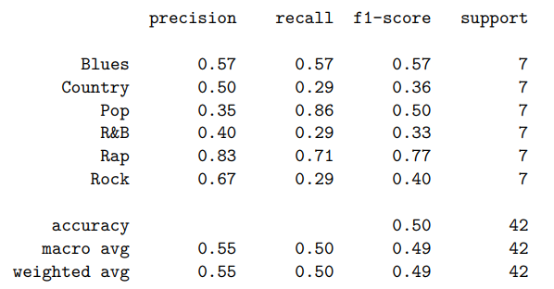
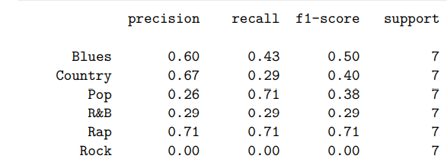

Multinomial Naïve Bayes (MultinomialNB)
Results obtained using the classification_report command and using 6-fold cross-validation
Unigram
Bigram

Slide 6
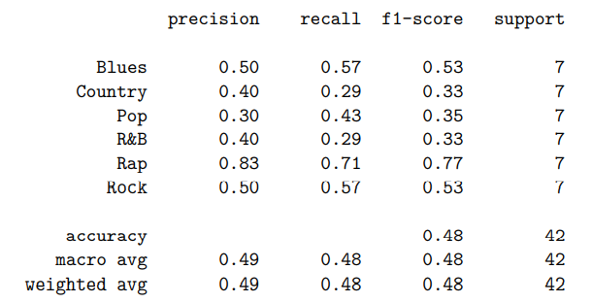
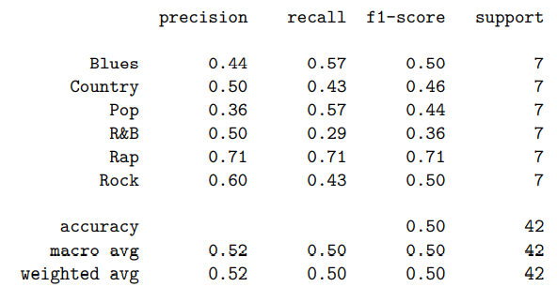
Support Vector Machine (SVM) (LinearSVC)
Results obtained using the classification_report command and using 6-fold cross-validation
Unigram
Bigram

Slide 7
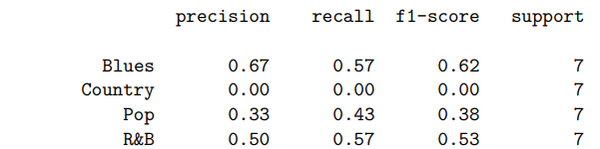
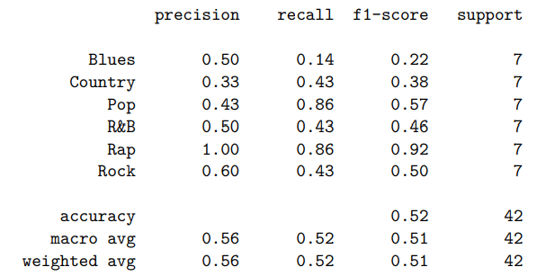
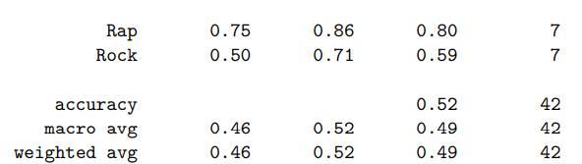
Random Forest (RandomForestClassifier)​
Results obtained using the classification_report command and using 6-fold cross-validation
Unigram
Bigram

Slide 8
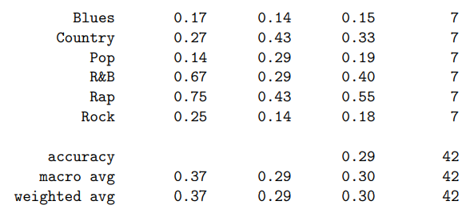

Neural Network (MLPClassifier)
Error – Incomplete Results
Results obtained using the classification_report command and using 6-fold cross-validation
Unigram
Bigram

Slide 9
Challenges and Solutions
A major challenge that we ran into when tuning and experimenting with the four models was that the test and training sets weren't large enough.
Because there weren't enough examples in each genre, even when utilizing stratification, the random shuffle made the results vary drastically each time we ran the models.
As a short term solution we used random_state as seed values but we decided that we will uniformly add more songs to our dataset to keep it balanced while making it more robust.

